Slide 1


Extending Azure AD MFA to Third-Party and On-Premises Devices
In today's increasingly complex and interconnected digital landscape, securing access to both cloud-based and on-premises resources has become a critical priority. This presentation will explore the powerful capabilities of Azure Active Directory Multi-Factor Authentication (Azure AD MFA) and how it can be seamlessly extended to protect a wide range of third-party and on-premises devices, ensuring a robust and comprehensive security posture for your organization.

Slide 2
Importance of Securing Third-Party and On-Premises Devices
Mitigating Risks
Maintaining Compliance
Enhancing User Experience
As organizations adopt a mix of cloud-based and on-premises technologies, it's essential to secure access to all devices and applications, regardless of their location or ownership. Extending Azure AD MFA to third-party and on-premises devices helps mitigate the risks of unauthorized access, data breaches, and other cybersecurity threats.
Many industries and regulatory bodies mandate strict security standards for accessing sensitive data and systems. By implementing Azure AD MFA across all devices, organizations can ensure compliance with these regulations and demonstrate a strong commitment to safeguarding their assets.
A consistent and seamless authentication experience across all devices and applications can improve user productivity and satisfaction. Azure AD MFA provides a user-friendly and streamlined approach to multi-factor authentication, ensuring a positive experience for both employees and customers.

Slide 3

Azure AD MFA Capabilities
1
Robust Authentication Methods
Azure AD MFA supports a wide range of authentication methods, including push notifications, SMS, voice calls, and mobile app-based verification, allowing users to choose the most convenient option for their needs.
2
Conditional Access Policies
Azure AD MFA integrates seamlessly with Conditional Access policies, enabling organizations to enforce multi-factor authentication based on various risk factors, such as location, device, and application access.
3
Adaptive Authentication
Azure AD MFA's adaptive authentication feature analyzes user behavior and device context to make real-time decisions on the level of authentication required, providing a balance between security and user convenience.
4
Azure AD Reporting and Analytics
Azure AD provides comprehensive reporting and analytics capabilities, allowing organizations to monitor MFA usage, identify security trends, and gain valuable insights to optimize their authentication strategy.

Slide 4

Integrating Azure AD MFA with Third-Party Applications
Cloud-Based Applications
On-Premises Applications
Azure AD MFA seamlessly integrates with a wide range of cloud-based applications, including Microsoft 365, Salesforce, ServiceNow, and many others, providing a unified and consistent authentication experience for users.
Azure AD MFA can also be integrated with on-premises applications through the use of the Azure AD Application Proxy, extending multi-factor authentication to legacy systems and ensuring secure access to critical resources.
Custom Applications
Third-Party Identity Providers
For custom-developed applications, Azure AD MFA offers various integration options, including Azure AD authentication libraries, REST APIs, and SAML-based authentication, allowing organizations to seamlessly incorporate multi-factor authentication into their own applications.
Azure AD MFA can be leveraged as an additional layer of security for users authenticating through third-party identity providers, such as Google, Facebook, or LinkedIn, ensuring a consistent and secure authentication experience across all user access points.

Slide 5
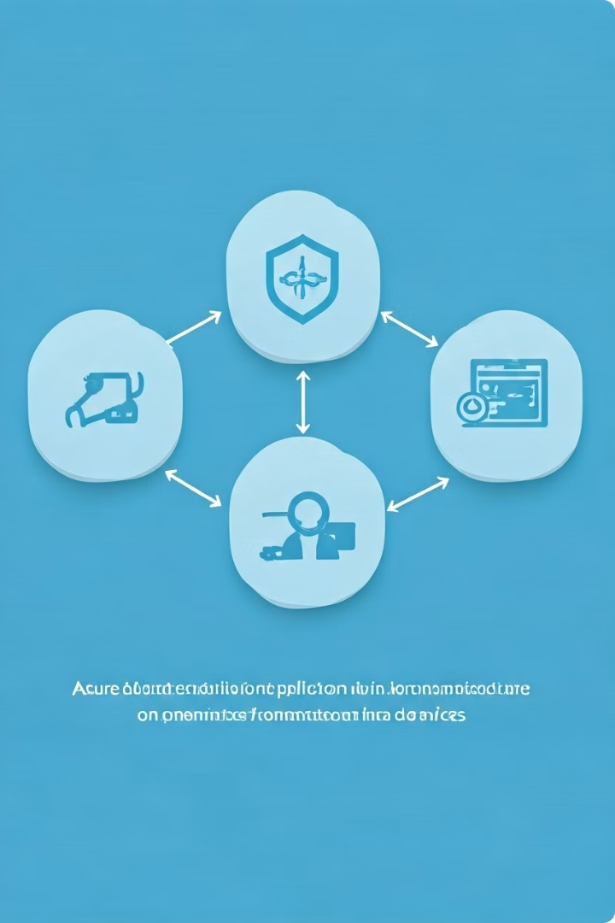



Extending Azure AD MFA to On-Premises Devices
Azure AD Connect
Azure AD Connect is the key to integrating on-premises Active Directory with Azure AD, enabling the extension of Azure AD MFA to on-premises resources, including legacy systems and applications.
Azure AD Application Proxy
The Azure AD Application Proxy acts as a secure bridge between on-premises applications and the cloud, allowing users to access these resources with the added security of Azure AD MFA.
On-Premises MFA Server
For organizations with specific on-premises requirements, the Azure AD MFA Server can be deployed to provide multi-factor authentication for both cloud and on-premises applications, ensuring a consistent user experience.

Slide 6

Deployment Considerations for Third-Party and On-Premises Devices
Discovery and Assessment
Phased Rollout
Start by identifying all the third-party and on-premises devices and applications that require protection, and assess their current security posture to determine the appropriate MFA implementation strategy.
Implement Azure AD MFA in a phased approach, starting with a pilot group or a specific set of applications, and gradually expanding the deployment to the entire organization, ensuring a smooth transition and minimizing disruption.
1
2
3
Planning and Architecture
Develop a comprehensive deployment plan that considers factors such as user adoption, integrations, reporting requirements, and any necessary changes to existing infrastructure or policies.

Slide 7





User Experience and Adoption Strategies
User Education
Provide comprehensive user training and resources to ensure a smooth transition to Azure AD MFA, educating users on the benefits, the authentication methods, and any changes to the login process.
Communication Plan
Develop a clear and consistent communication plan to keep users informed about the MFA deployment, address any concerns, and provide ongoing support to drive user adoption and acceptance.
User Feedback
Actively solicit and address user feedback, incorporating their input to refine the MFA implementation and ensure a positive user experience that balances security and productivity.
Incentive Programs
Consider implementing incentive programs or gamification strategies to encourage user participation and adoption, fostering a culture of security awareness and responsibility.

Slide 8

Monitoring and Reporting for Extended Azure AD MFA
Metric
Description
Benefit
MFA Adoption Rate
The percentage of users who have enabled and are actively using Azure AD MFA.
Helps identify opportunities for increased user education and adoption efforts.
Authentication Methods Used
The distribution of authentication methods used by your users, such as push notifications, SMS, or voice calls.
Provides insights to optimize the available authentication options and tailor the user experience.
Conditional Access Policies
The number and effectiveness of Conditional Access policies enforcing Azure AD MFA for specific scenarios.
Ensures the appropriate level of security controls are in place and may identify areas for policy refinement.
Security Insights
Reports on potential security risks, such as suspicious login attempts or MFA bypass attempts.
Enables proactive threat detection and response, strengthening the overall security posture.

Slide 9
Troubleshooting and Maintenance
Troubleshooting Challenges
Maintenance Considerations
Incident Response and Escalation
Identify and address common troubleshooting scenarios, such as user authentication issues, device enrollment problems, or connectivity disruptions, to ensure a smooth and reliable Azure AD MFA experience.
Establish proactive maintenance practices, including regular policy reviews, user training updates, and system health checks, to ensure the ongoing effectiveness and optimization of the Azure AD MFA implementation.
Develop a comprehensive incident response plan to quickly address and mitigate any security incidents or MFA-related disruptions, leveraging Azure AD's reporting and analytics capabilities to facilitate a swift and effective response.

Slide 10

Conclusion and Next Steps
1
Secure Access for All
By extending Azure AD MFA to third-party and on-premises devices, organizations can enhance their overall security posture, protect critical resources, and provide a consistent and user-friendly authentication experience across the entire digital ecosystem.
2
Ongoing Optimization
Continuously monitor, analyze, and refine the Azure AD MFA implementation to ensure it remains effective, efficient, and aligned with the organization's evolving security requirements and user needs.
3
Embracing the Future
As the digital landscape continues to evolve, leveraging the robust capabilities of Azure AD MFA will be a crucial step in safeguarding your organization's assets and preparing for the challenges and opportunities that lie ahead.

